Slide 1


IDQ Address Validator

Slide 2
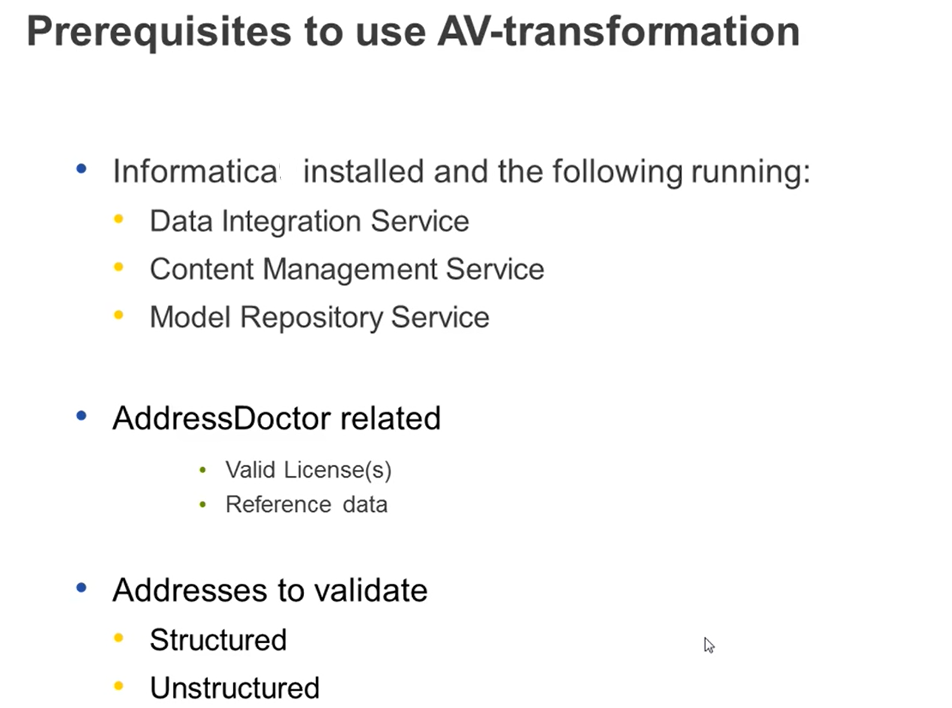

Slide 3
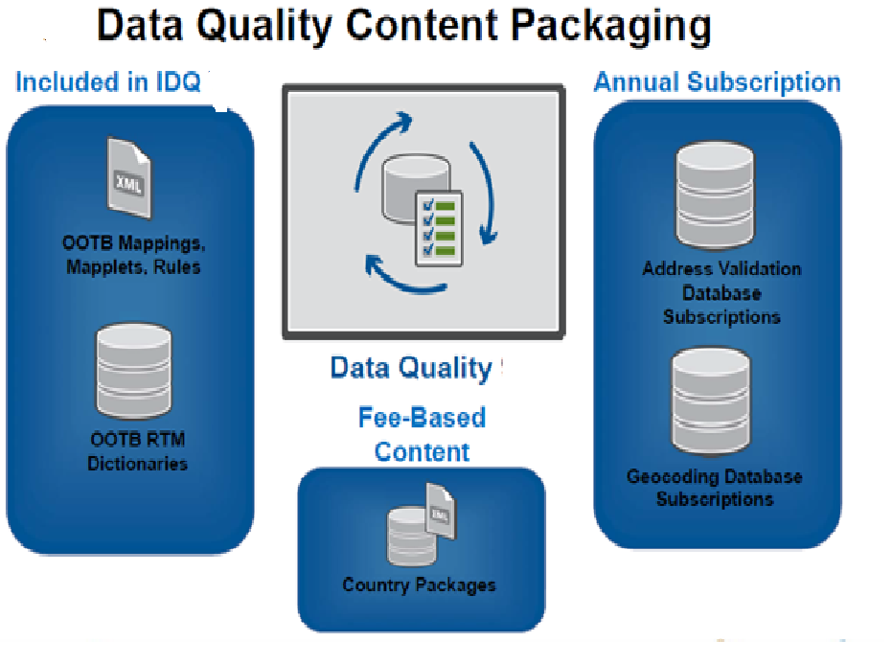

Slide 4
Standardize and Validate Valuable Customer Data
Informatica Data Quality Content Options standardize name and address data and validate address delivery points based on geography
Informatica Data Quality Accelerators These accelerators consist of prebuilt mappings, mapplets, rules, and RTM dictionaries built to solve common data quality problems associated to the particular regional package. Business name RTM dictionaries, personal ID validation rules, and cultural-specific matching rules are available within these accelerators.
Standard Address Parsing Package This package supplies address standardization dictionaries at a city, state/province, and postal code level for more than 180 countries

Slide 5
Standardize and Validate Valuable Customer Data
Premium Worldwide Address Cleansing and Standardization These subscription packages provide the highest quality address reference data from reputable sources around the globe.
These subscriptions provide address cleansing and standardization for more than 240 countries supporting seven different writing systems.
Geocoding Option Subscriptions These subscriptions provide the necessary reference data to apply latitude and longitude geocoordinates to address data.
The geocoding option assigns coordinates at a “roof-top” level and provides a fall-back geocode when appropriate

Slide 6
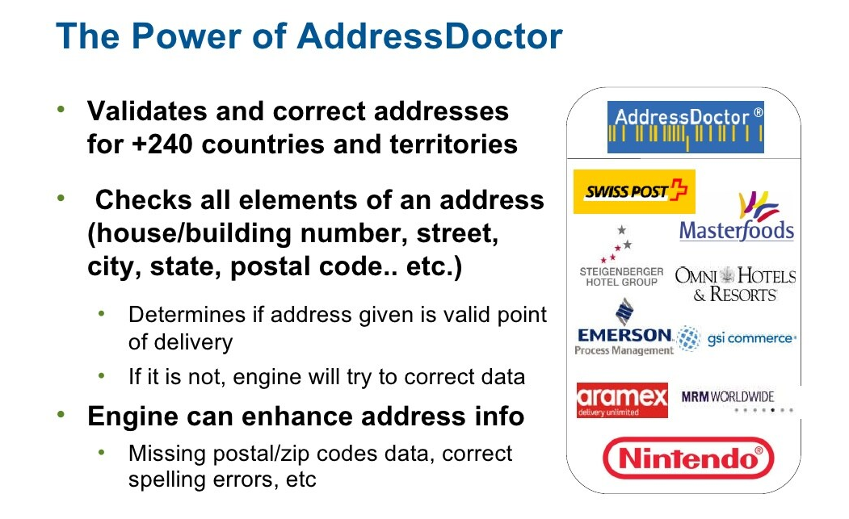

Slide 7
IDQ Address Validator ➔ Process

Slide 8
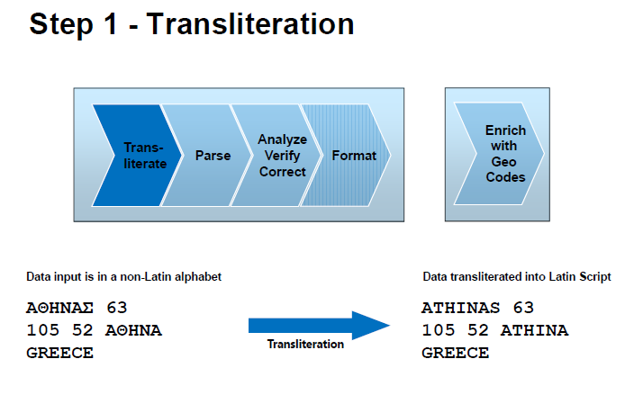

Slide 9
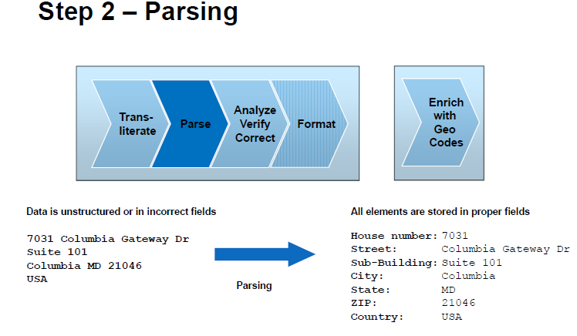

Slide 10
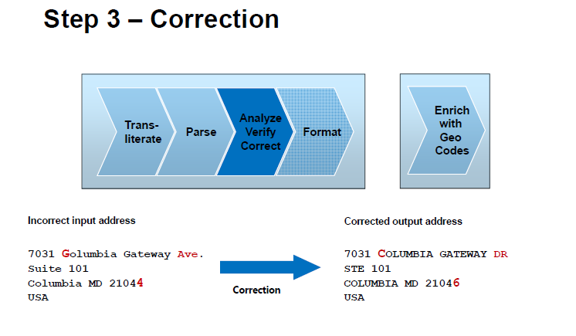

Slide 11
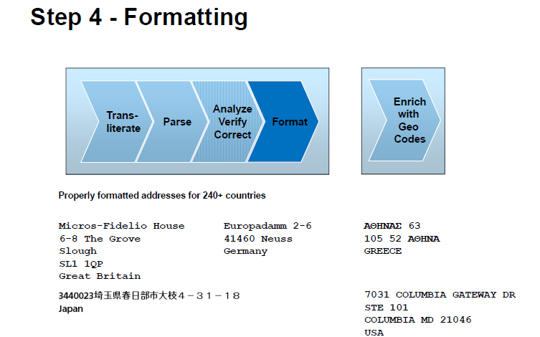

Slide 12
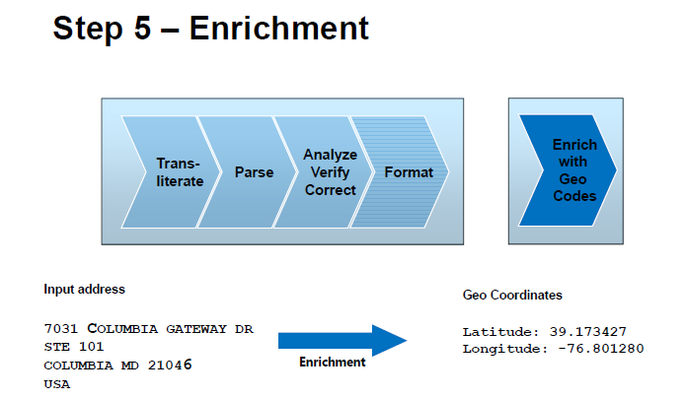

Slide 13
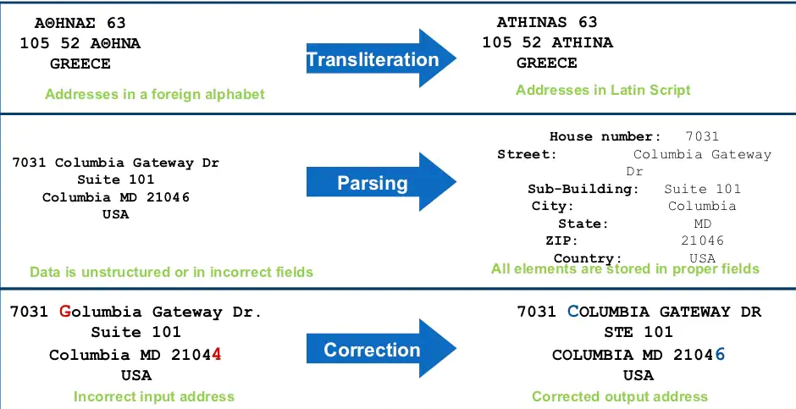

Slide 14
IDQ Address Validator –Type of Reference Data

Slide 15
.
Address code lookup data
You can lookup Address DATA for 240 Country
Types of Address Reference Data
Address code lookup data
Batch and interactive data
CAMEO data
Certified data
Geocode data
Supplementary data
Use batch and interactive data to verify that the input addresses are fully deliverable and complete based on the current postal data from the national mail carrier.
CAMEO data to add customer segmentation data to residential address records.
Customer segmentation data indicates the likely income level and lifestyle preferences of the residents at each address.
Address Validator transformation reads CAMEO data when you configure the transformation to run in batch mode or certified mode.
Certified data to verify that address records meet the certification standards
Australia ➔ Certifies mail according to the Address Matching Approval System (AMAS) standard
United States ➔ Certifies mail according to the Coding Accuracy Support System (CASS) standard.
geocode data to add geocodes to address records. Geocodes are latitude and longitude coordinates.

Slide 16
IDQ Address Validator➔ At glance

Slide 17
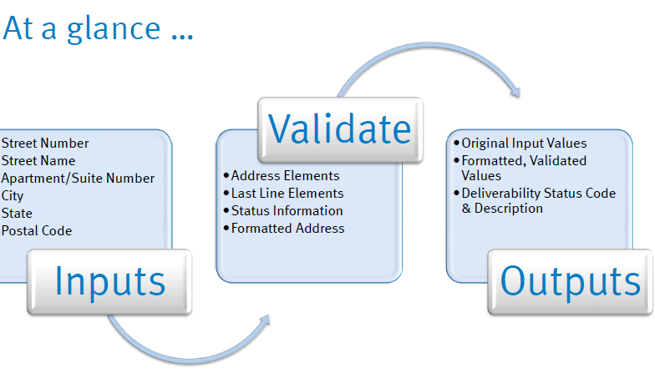

Slide 18
Task 1 : Create New Mapping ➔ ALL _CUSTOMER (Read) + ADD Address Validator Transformation

Slide 19
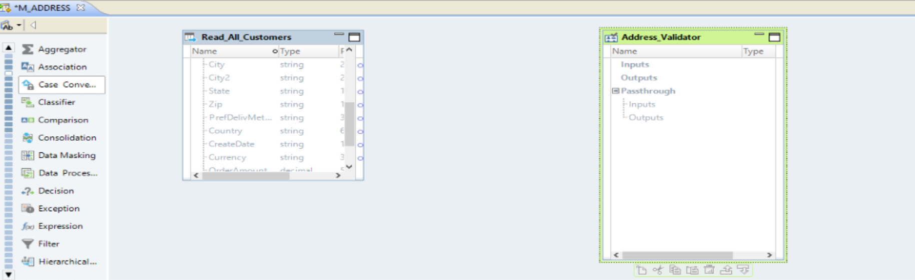

Slide 20
Task 2 : Address Validator Transformation ➔ Input Group from Template

Slide 21
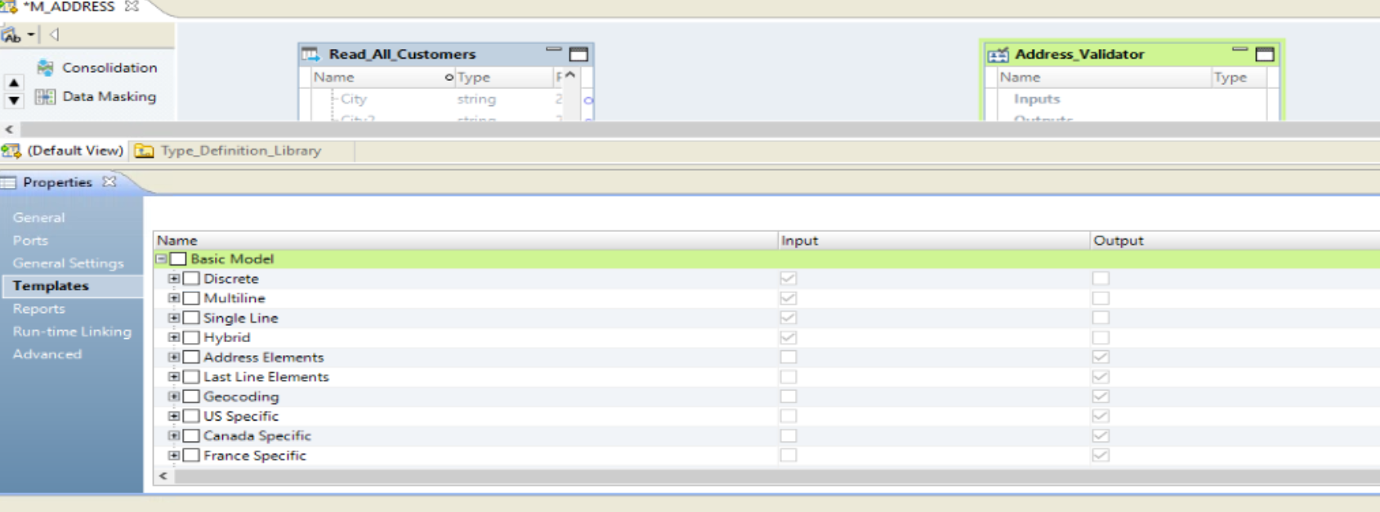

Slide 22
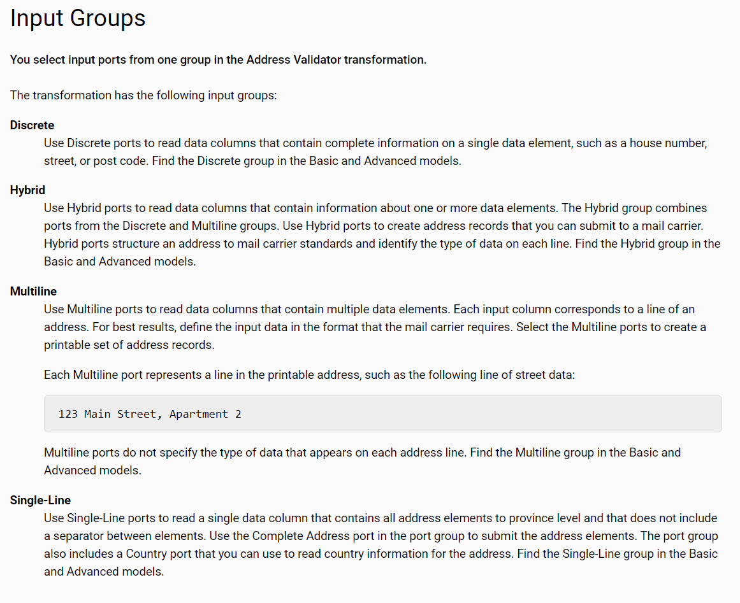

Slide 23
Task 2B : Address Validator Transformation ➔ Template ➔ Basic ➔ Discrete

Slide 24
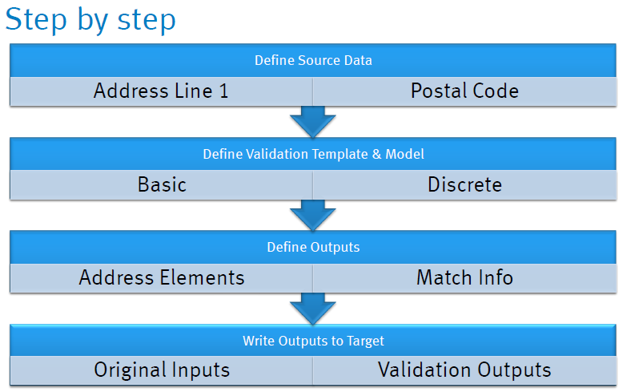

Slide 25
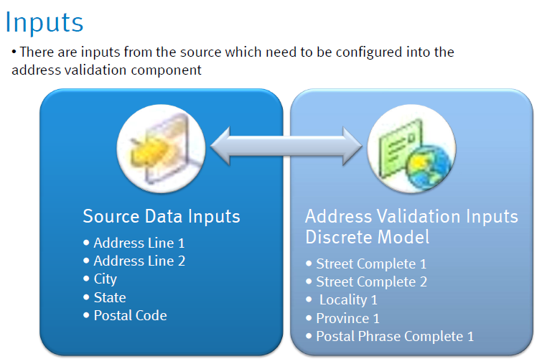

Slide 26
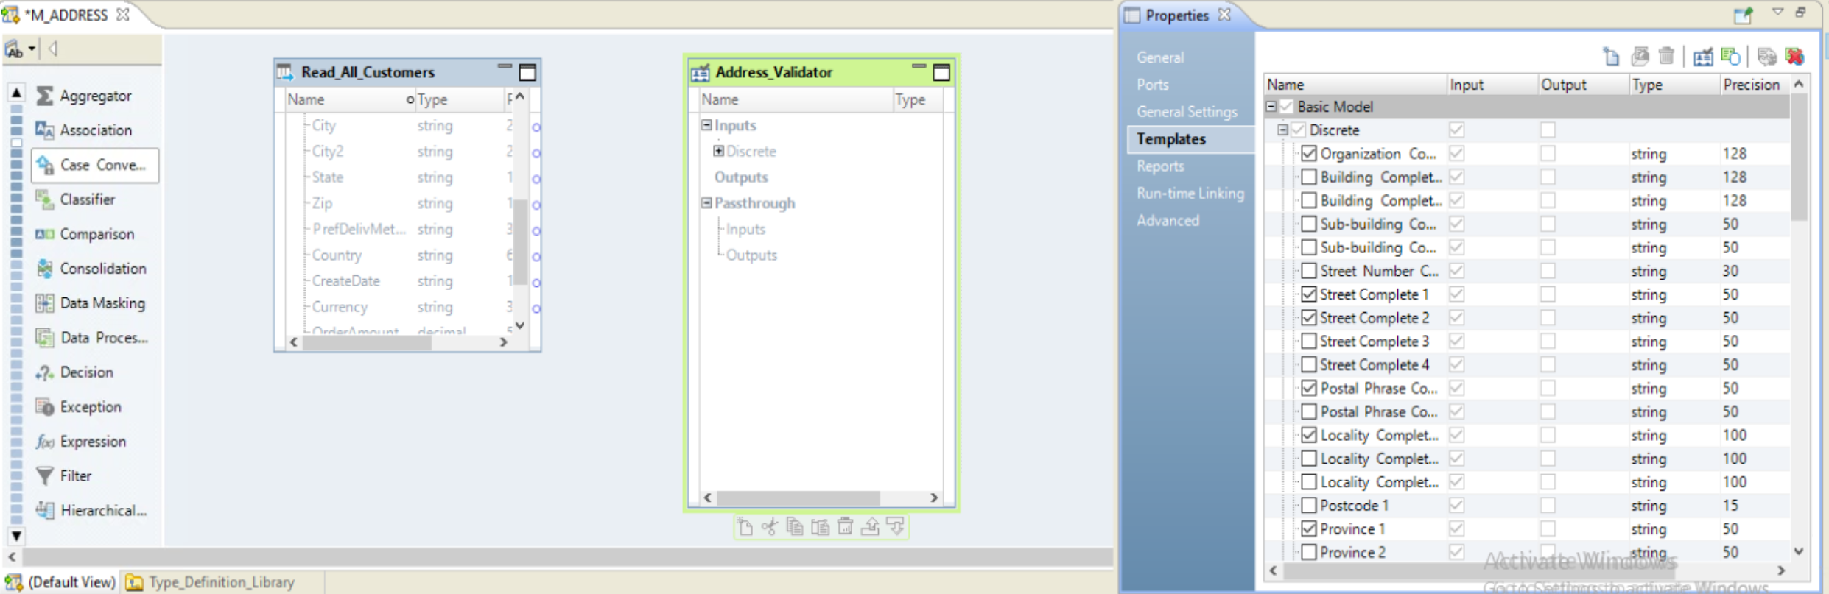

Slide 27
Task 2c : Address Validator Transformation ➔ Output Group

Slide 28
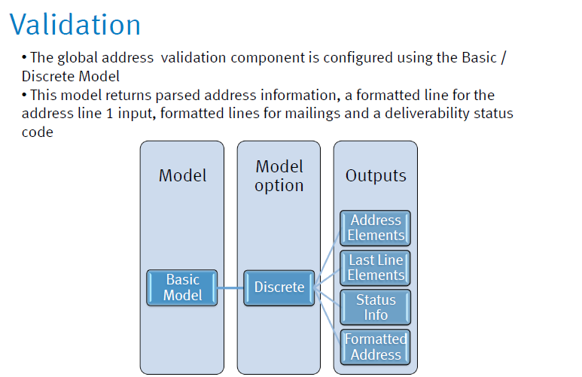

Slide 29
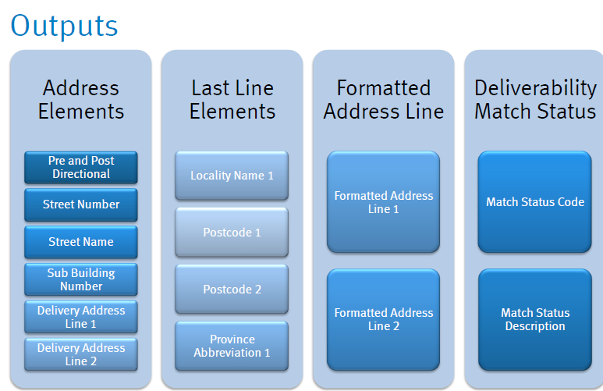

Slide 30
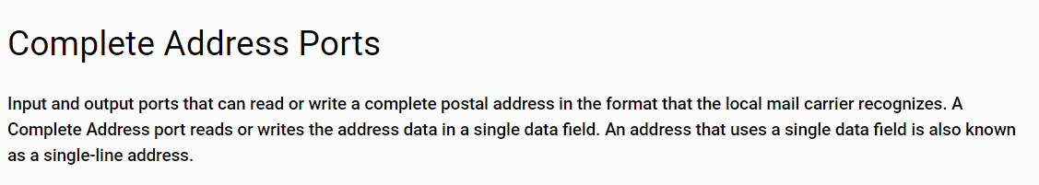
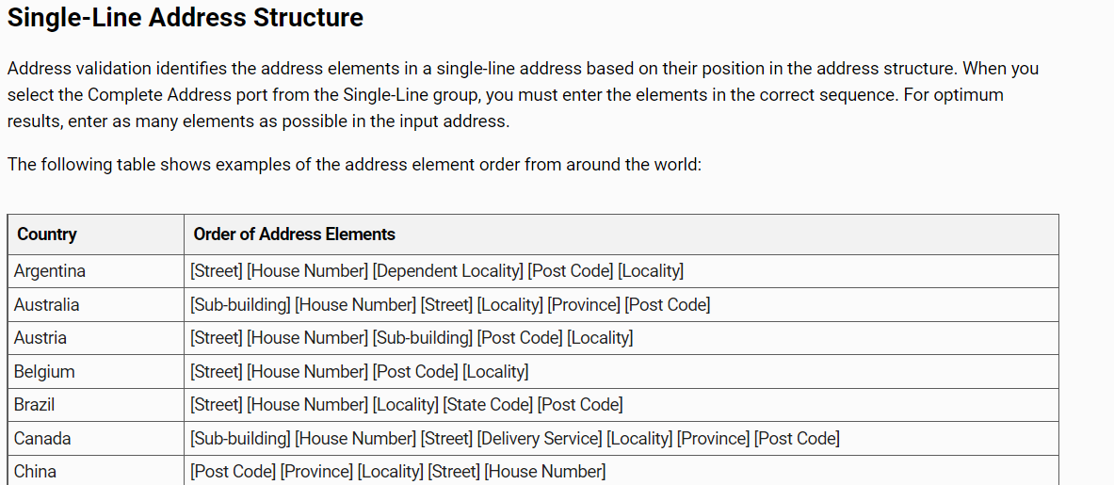
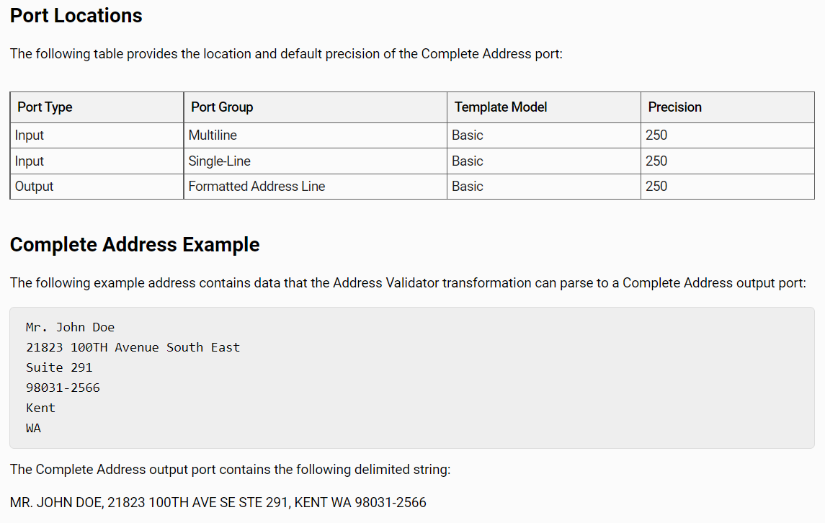

Slide 31

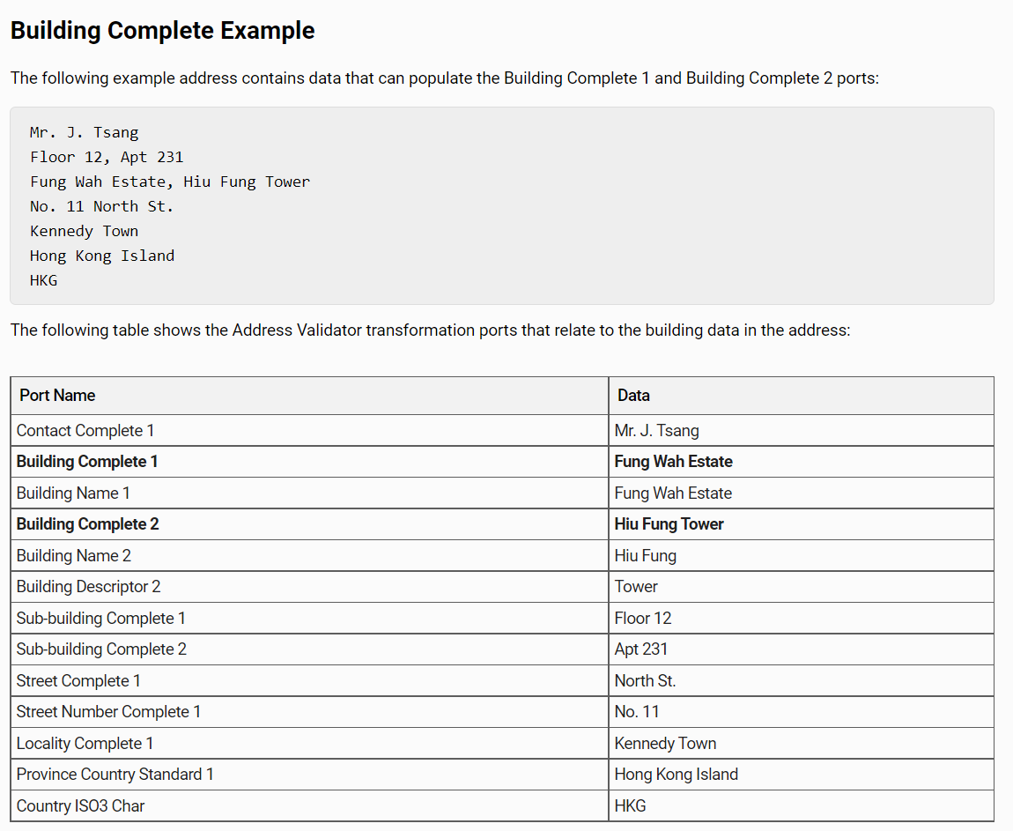
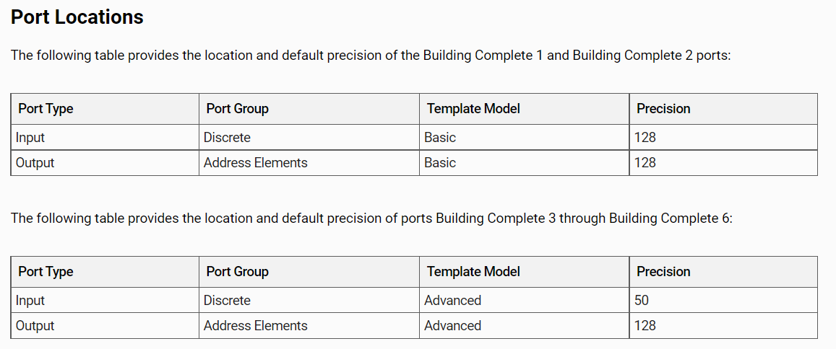

Slide 32
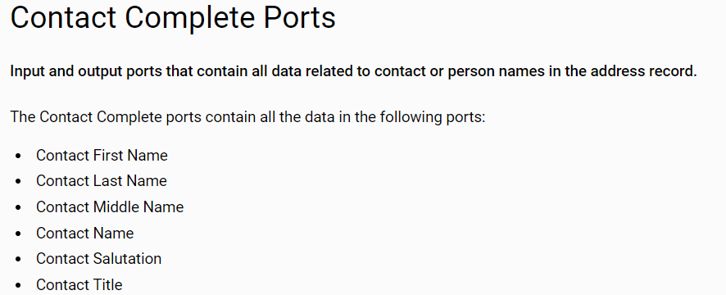
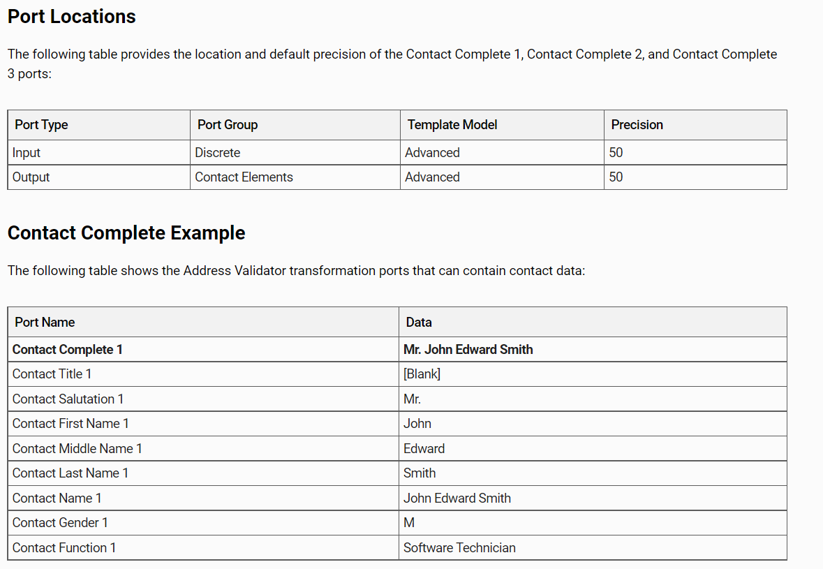

Slide 33
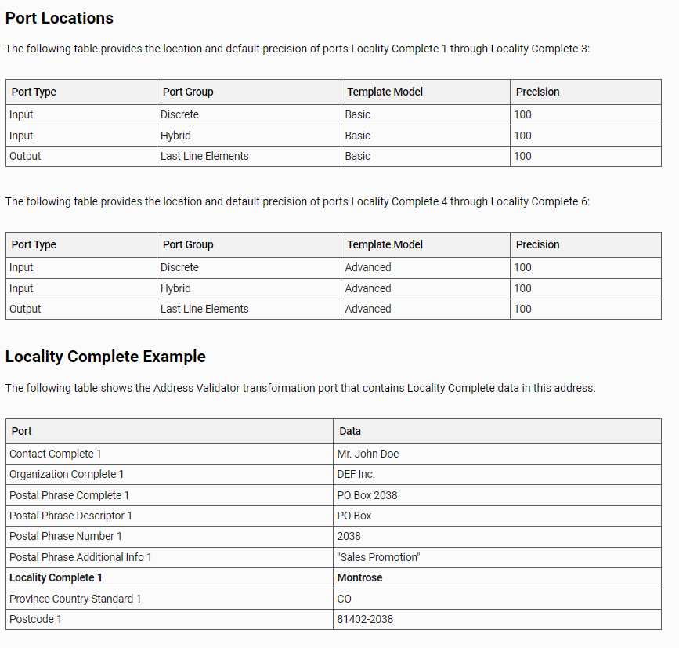

Slide 34

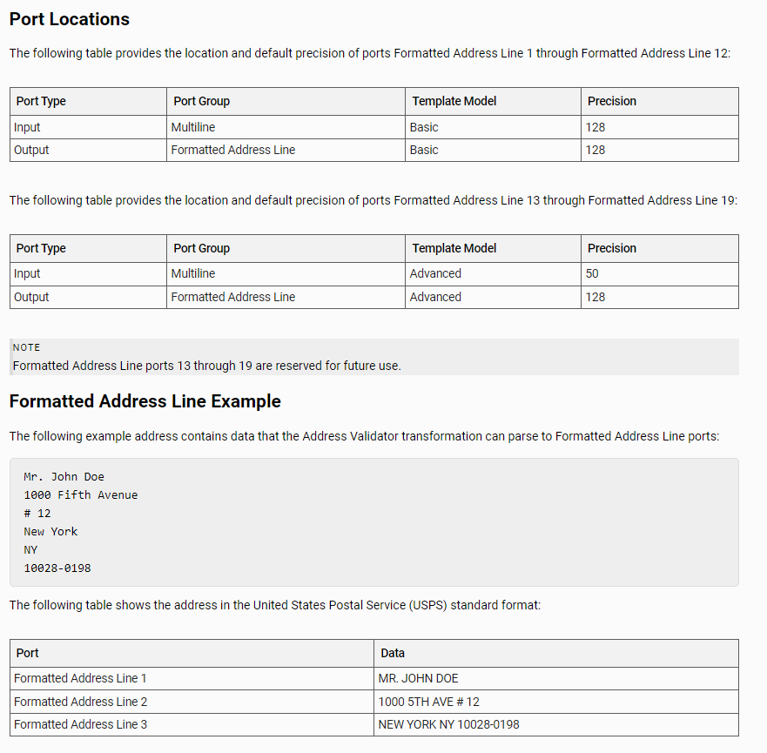

Slide 35
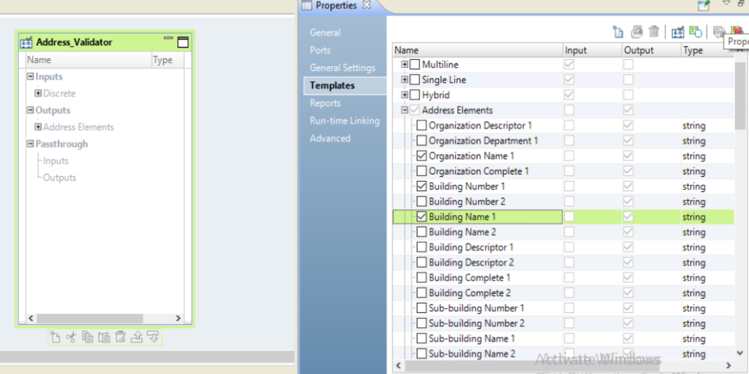
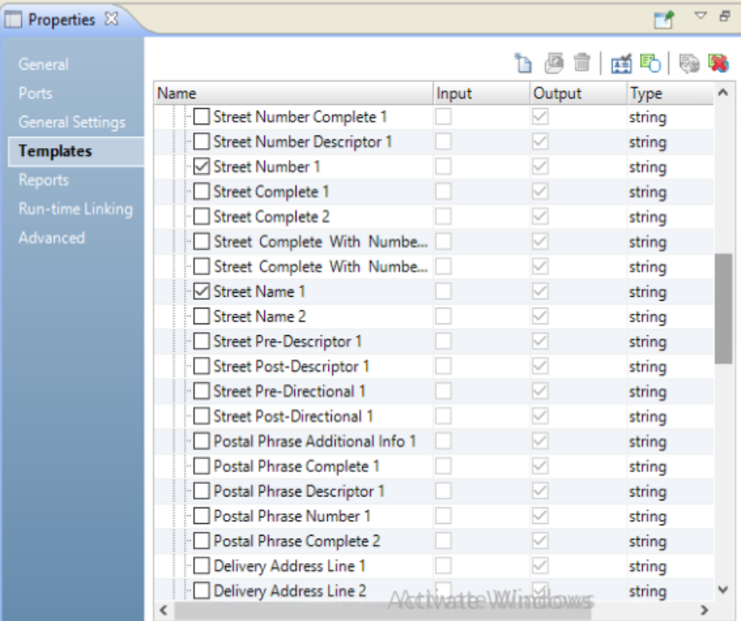
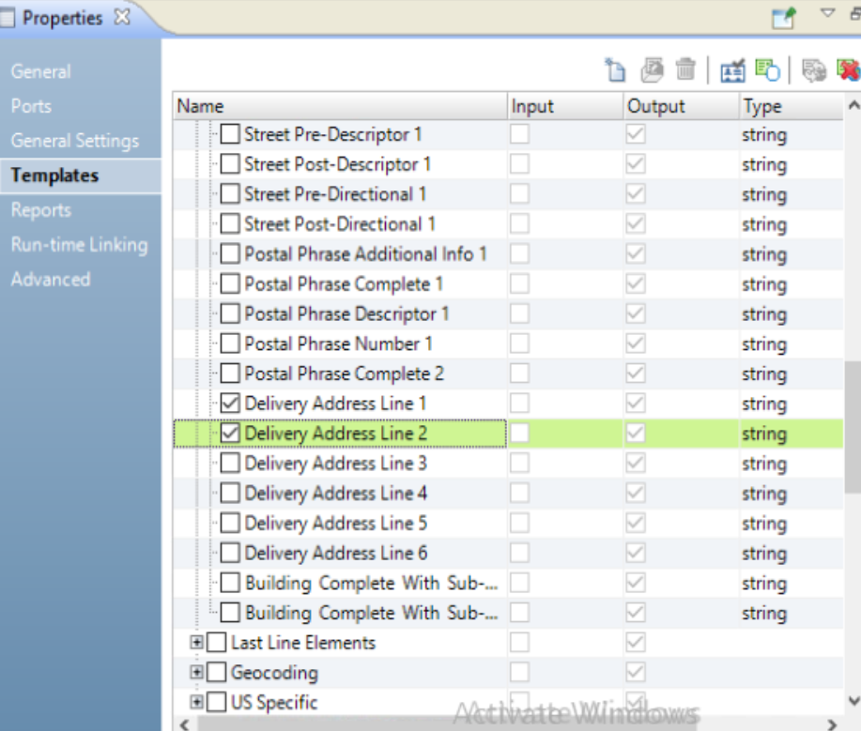
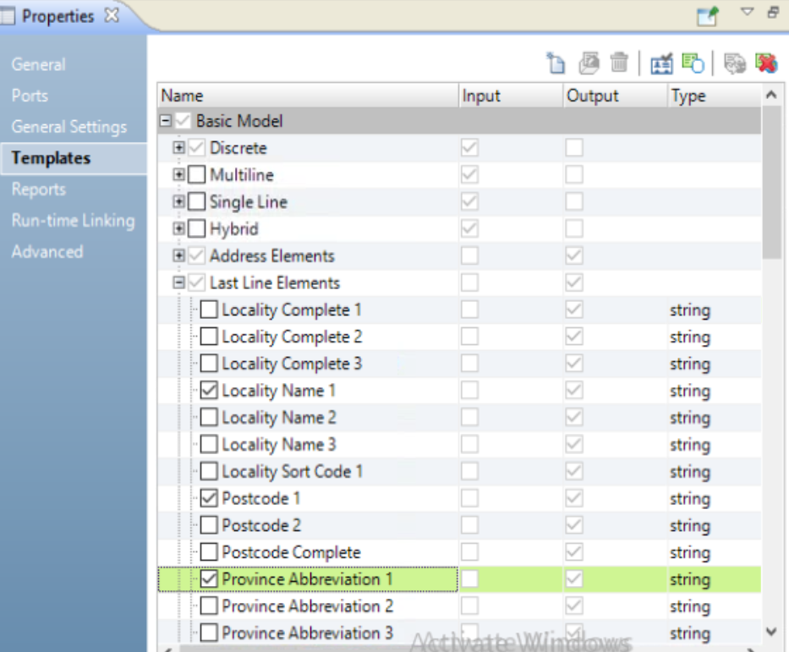

Slide 36
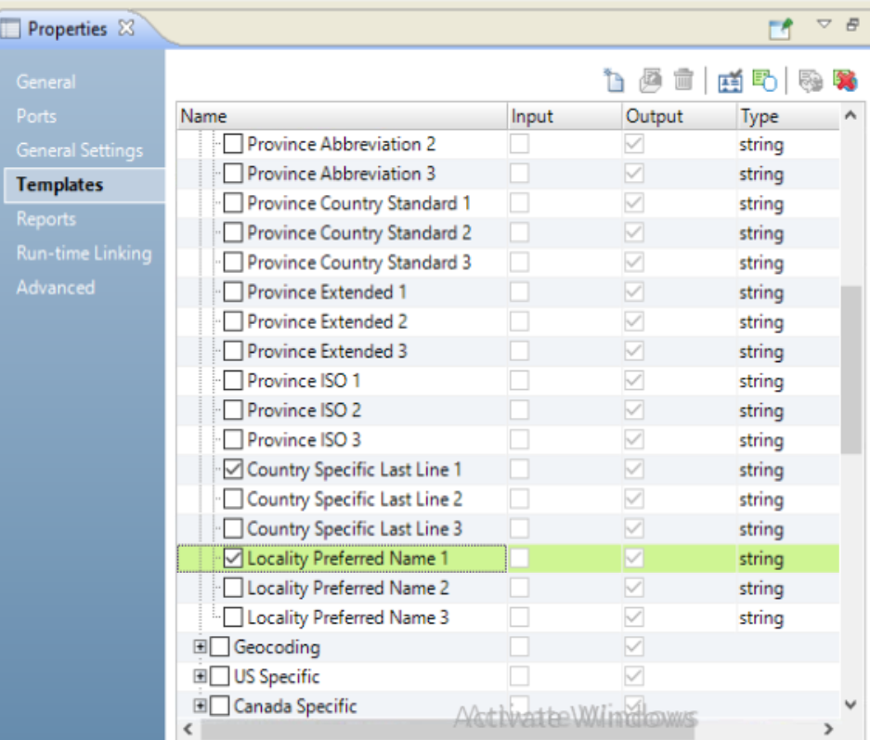
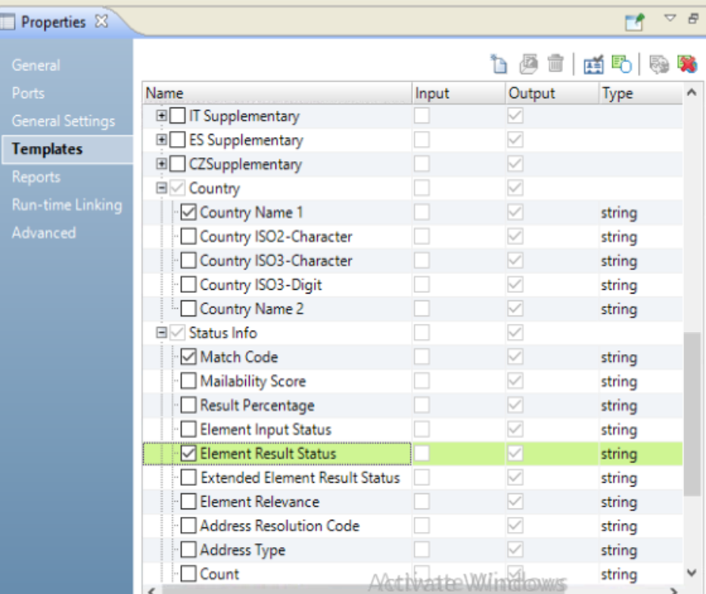
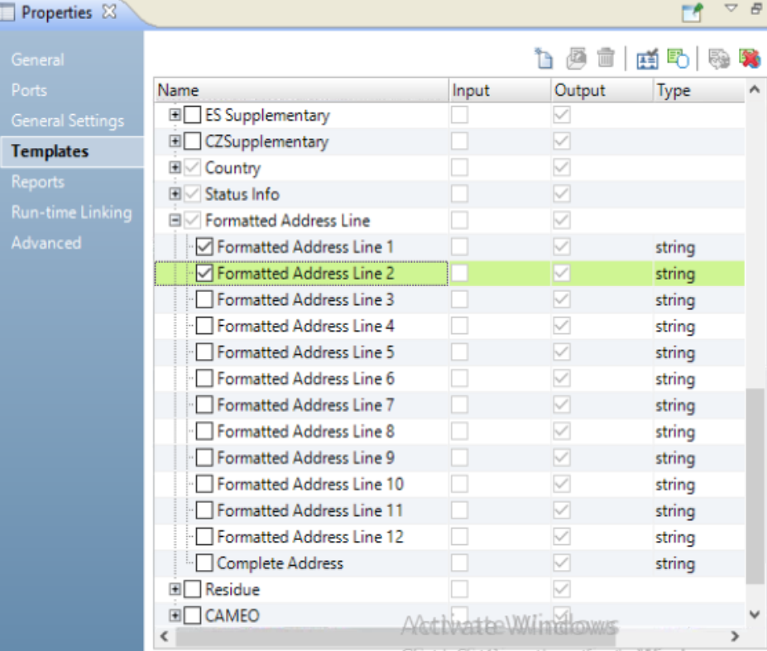

Slide 37
Task 2d : Configure Address Validator Transformation ➔ Input Port from ALL_CUSTOMER

Slide 38
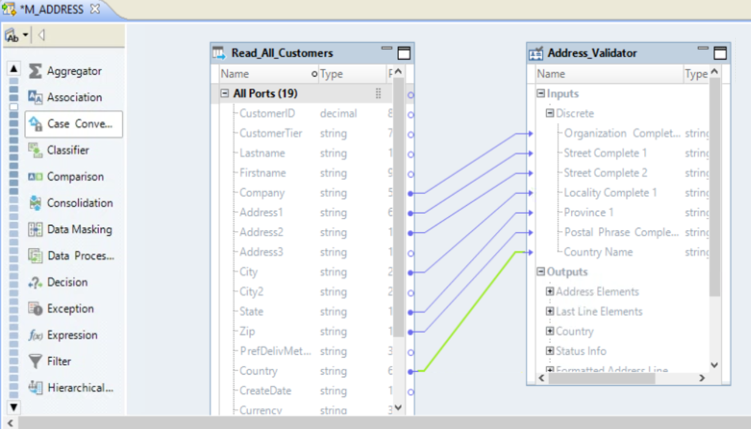

Slide 39
Address Doctor➔ Match Code and Mailability Score

Slide 40
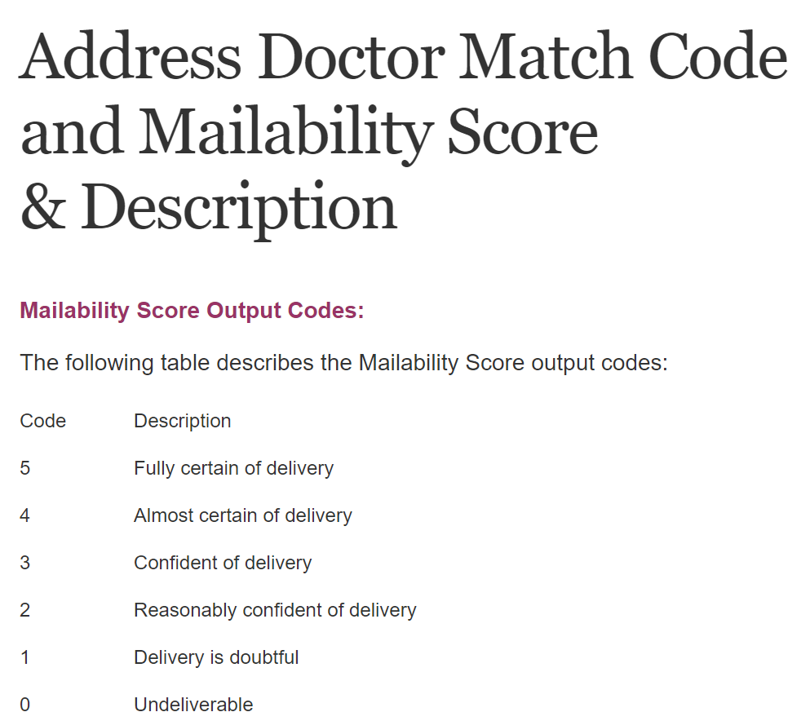
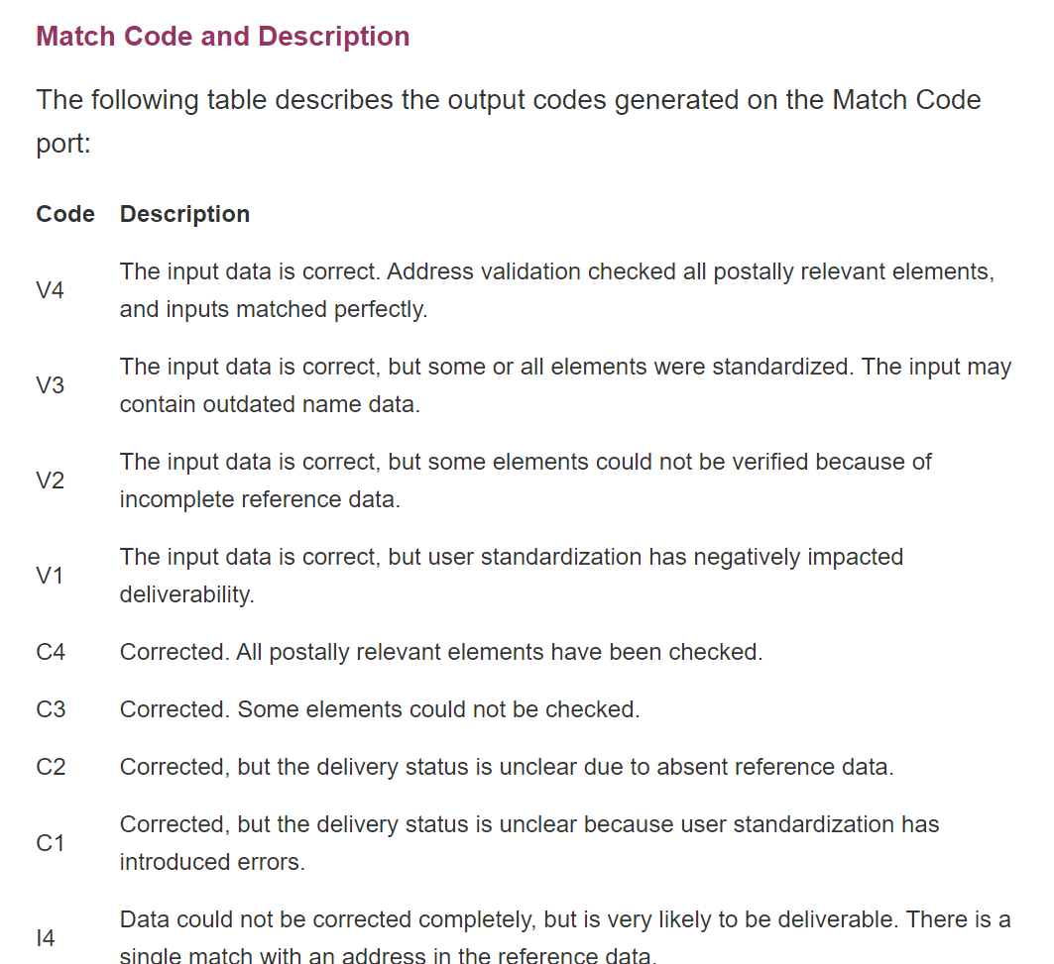

Slide 41
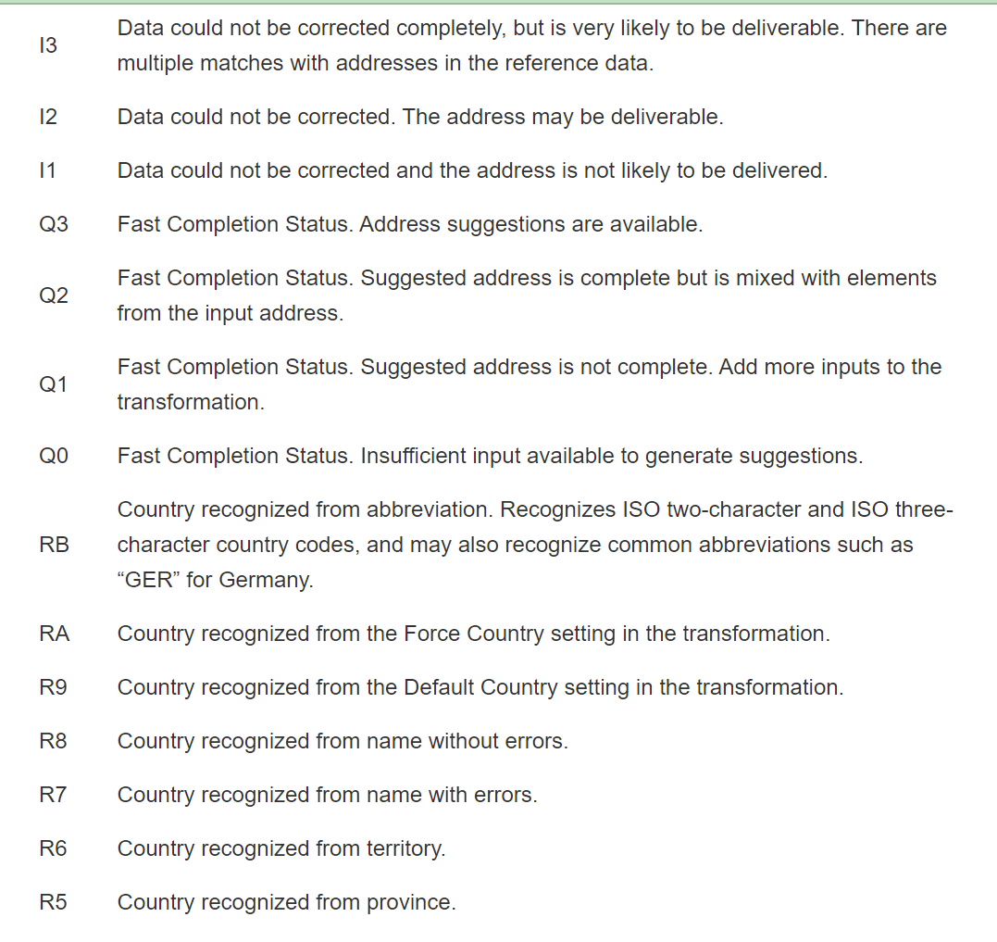

Slide 42
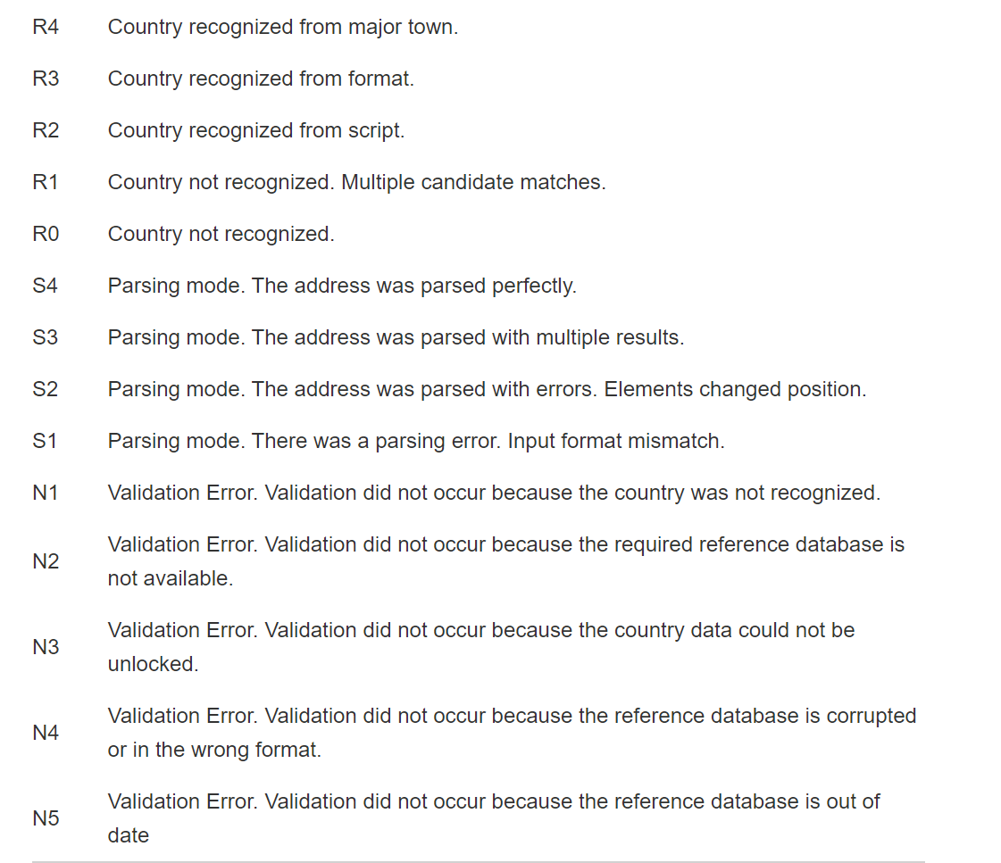

Slide 43
Task 2E : Run Data Viewer Address Validator Transformation

Slide 44
